Slide 2
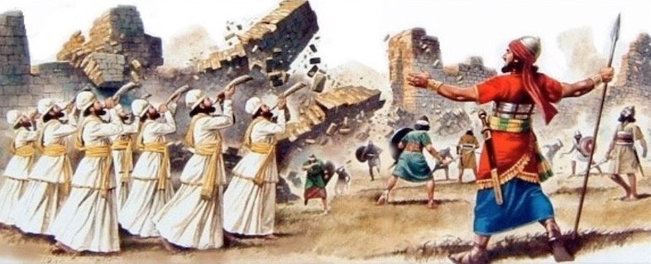
God Graciously gave Jericho to Israel – Joshua Chapter Six

Slide 3
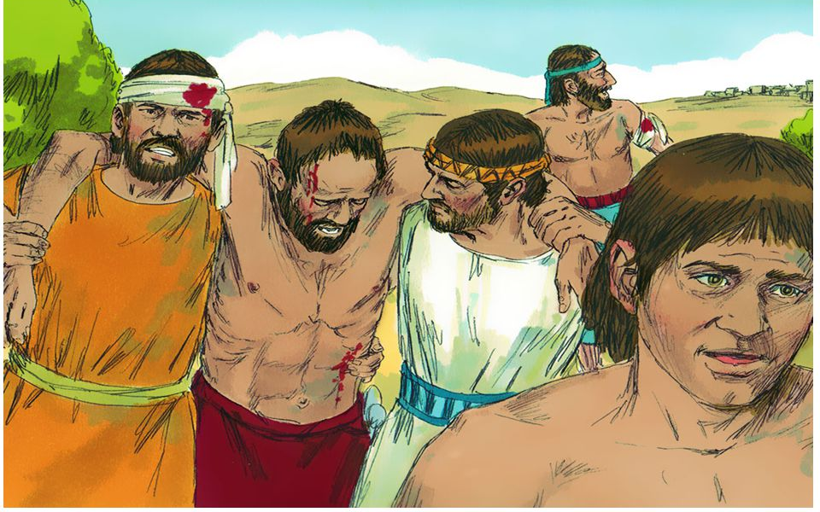
“Israel fled before the men of Ai” Joshua 7:4,5

Slide 4
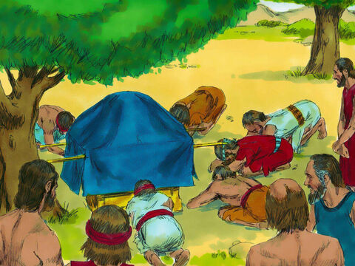
“he and the elders of Israel…put dust on their heads” Joshua 7:6-9

Slide 5
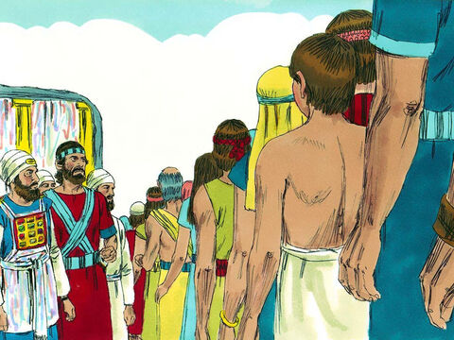
“the family which the Lord takes shall come by households” Joshua 7:6-9

Slide 6
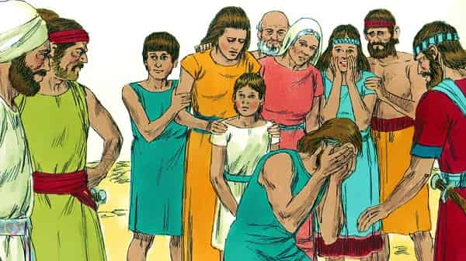
“tell me now what you have done; do not hide it from me."” Joshua 7:19

Slide 7

“I have sinned against the Lord God of Israel” Joshua 7:20,21

Slide 8
How Sin Works:
1. «I SAW» Genesis 3:6 «saw that the tree was good for food»
2. «I COVETED THEM» «pleasant to the eyes...desirable»
3. «TOOK THEM» «she took of its fruit and ate.»

Slide 9
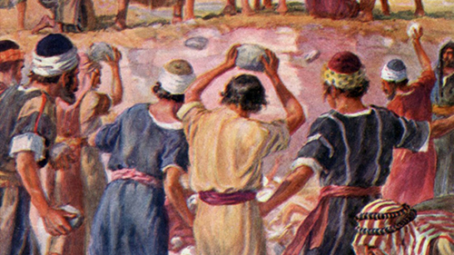
“all Israel stoned him with stones; and they burned them with fire” Joshua 7:24-26

Slide 10
Caused a Whole Nation to Suffer!
Hebrews 2:2,3

Slide 11
THE SIN Of ACHAN
“One sin won’t hurt.”
James 2:10 “one point… guilty of all”
Eve’s ONE SIN brought DEATH into the world – Genesis 3
Moses’ ONE SIN – Numbers 20:7-13
Nadab & Abihu – Leviticus 10
Uzzah – 2 Samuel 6:1-8
Ananias & Sapphira – Acts 5

Slide 12
THE SIN Of ACHAN
Rich Young Ruler lacked ONE THING to inherit eternal life – Luke 18:22,23
Simon the sorcerer was “poisoned by bitterness…bound by iniquity” after ONE SIN – Acts 8:23
ONE SIN launches MANY – Joseph’s brothers envious of him – hated him – conspired to do him harm- Genesis 37
David looked with LUST at Bathsheba - one sin led to another – murdered her husband – 2 Samuel 11

Slide 13


THE SIN Of ACHAN
Apostasy Occurs One Step At A Time – 2 Timothy 4:1-4
Do not endure SOUND DOCTRINE
Heap up their own teachers to SCRATCH THEIR EARS
Turn away to FABLES!
GOING……….
Each Sin we learn to TOLERATE makes it easier to TOLERATE the NEXT!

Slide 14
THE SIN Of ACHAN
“Ones sin is nobody’s business but his own!”
Joshua 7:1,11 “Israel has sinned…”
Also affected his family – Joshua 7:24
Fornicator at Corinth affected whole church – 1 Corinthians 5:6
“One can keep sins hidden!”
Numbers 32:23 “your sin will find you out.”
Hebrews 4:13 ”all things are naked and open”
2 Corinthians 5:10 “all appear before the judgment seat of Christ”

Slide 15
One Sin, Not Repented of, Can Make a Big Difference!
Don’t Delude Yourself!
Mess Around With SIN
You Will Pay The Price!

